Slide 1

Presentation on XGBOOST FOR BREAST CANCER PREDICTION
By :
Vaibhav Chaudhari (2017B5A70834G)

Slide 2
AIM
Paper Referred- Random forest for breast cancer prediction
Additional inputs – XGBoost implementation.

Slide 3
Introduction
Most common cancer in women impacting 2.1 million women yearly and also second leading cause of cancer death in women.
Early detection with accuracy is critical.
Most Researchers use Machine Learning techniques for research.
Therefore it is critical that the algorithm has maximum accuracy.
Compared two models based on accuracies namely: XGBoost and Random Forest Classifier.

Slide 4
RANDOM FOREST CLASSIFIER
Ensemble result of a large number of decision trees.
Each tree only trains some subset of the full training dataset.

Slide 5
XGBOOST (eXtreme Gradient BOOSTing)
Decision-tree-based ensemble algorithm that uses a gradient boosting framework.
Boosting involves training weak learners which try to correct its predecessor.
Errors minimized by gradient descent algorithm.
Systems Optimization and Algorithmic Enhancements.

Slide 6
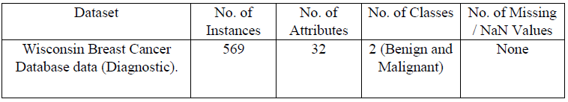
Data Description
Wisconsin Breast Cancer Database (WBCD) data (Diagnostic).
2 Nominal Attributes - Id and Diagnosis
3 types of 10 real- valued Attributes (30 features)

Slide 8
Data Cleaning – No NaN value present in dataset.
Label Encoding – For the attribute Diagnosis.
Correlational Matrix – Threshold value= 0.9 (21 features remain)
Correlation Heatmap helps to better visualize the correlation.

Slide 9
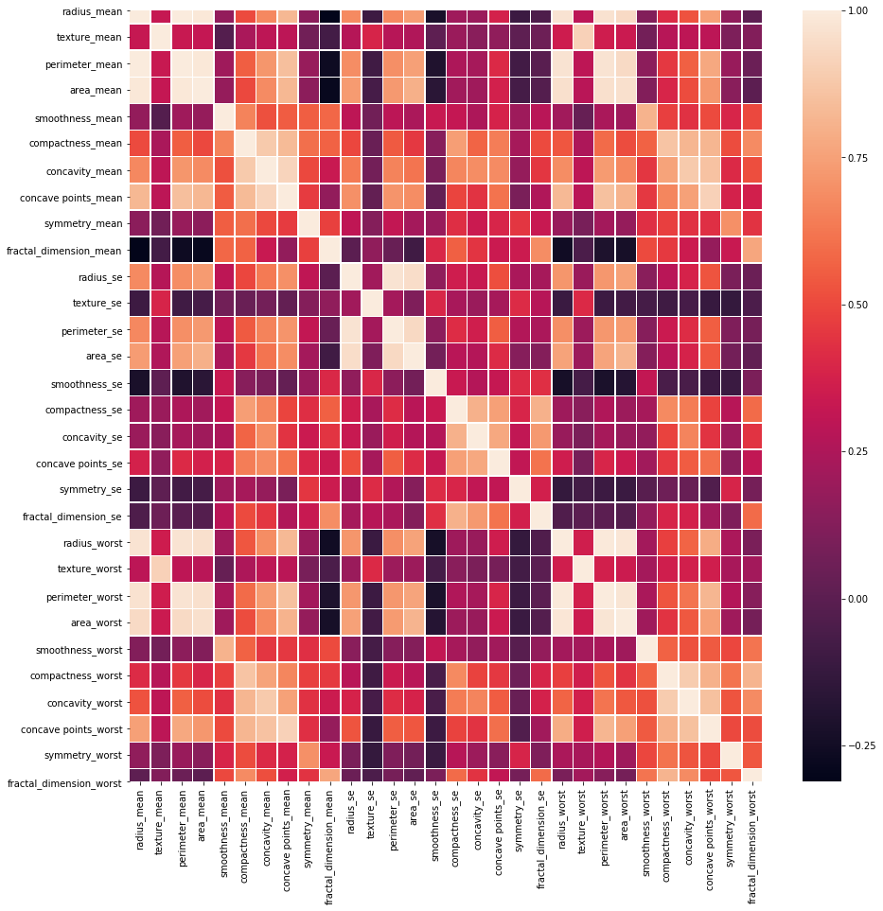

Slide 10
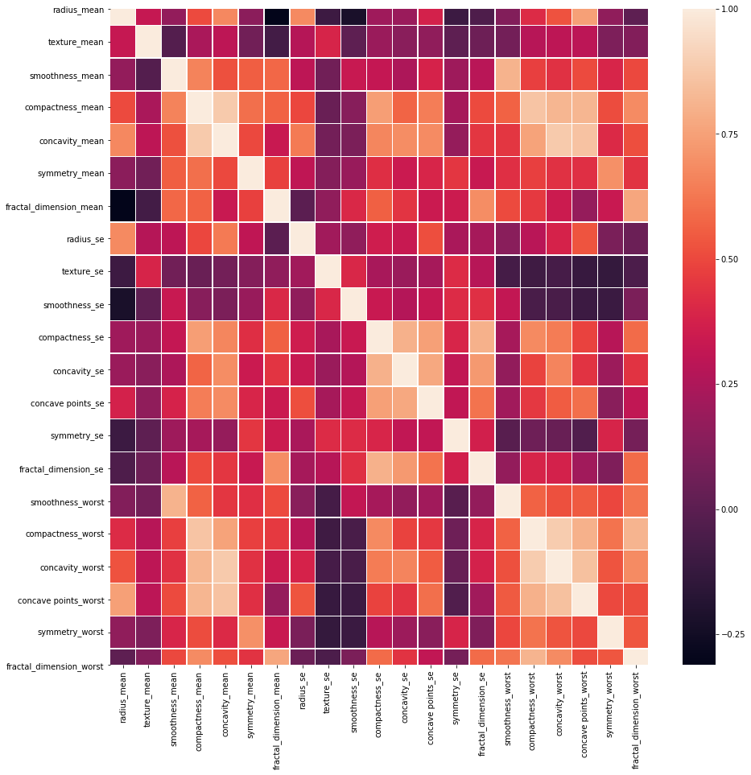

Slide 11
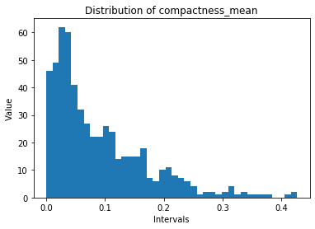
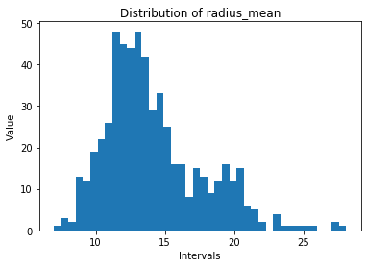
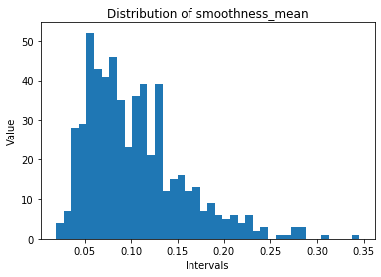
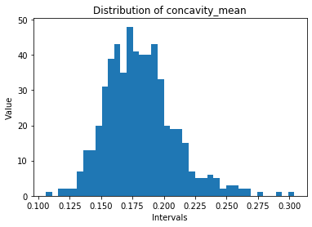

Slide 12
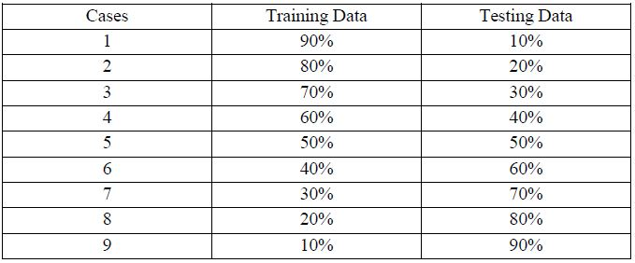
METHODOLOGY
Splitting Data into Training and Testing
sklearn.model_selection library - train_test_split function

Slide 13
Random Forest
sklearn.ensemble library - RandomForestClassifier function.
n_estimators – number of trees in the forest (50)
max_depth – maximum depth of the tree
criterion – function to measure quality of split (gini)
XGBoost
xgboost library - XGBClassifier function.
n_estimators – number of trees in the forest (1000)
max_depth – maximum depth of the tree (30)
learning_rate – boosting learning rate (0.2)

Slide 14


Accuracy
sklearn.metrics library – accuracy_score function
y_true – Ground truth labels
y_pred – predicted labels

Slide 15
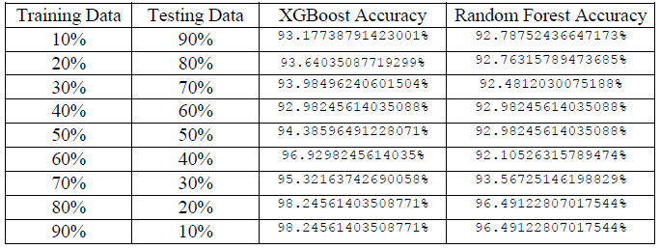
RESULTS

Slide 16
Legend :
XGBoost – Black
RF - Green

Slide 17
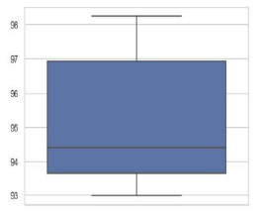
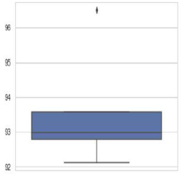
VISUALIZATION OF THE RESULTS
Box – Plot for XGBoost
Box – Plot for Random Forest

